Slide 1
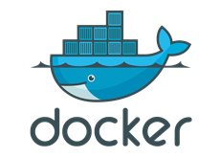
Docker Commands and Structures

Slide 2
Docker Network Remove
Remove one or more networks
docker network rm NETWORK [NETWORK...]

Slide 3
Docker Container Lifecycle
Purpose | Command | Meaning
Conception | build | Build an Image from a Dockerfile
Birth | run | (create + start) a container
Reproduction | commit run | (persist) a container to a new image Run a new container from an image
Sleep | kill | Kill a running container
Wake | start | Start a stopped container
Death | rm | Delete a stopped container
Extinction | rmi | Delete a container image

Slide 4
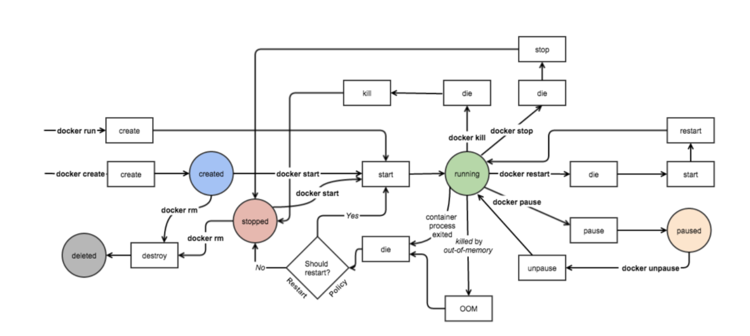
Docker Container Lifecycle

Slide 5
Getting Started with Docker
create and run a Container
start , stop and restart
pause and unpause
daemonized
rename a container
Search, pull and push an image

Slide 6
Getting Started with Docker (Cont.)
rmi and rm
save and load an image
export and import a container
attach , monitor and info
events, inspect and cp
exec, diff, history and kill

Slide 7
Creating a Container
Creates a new container
Syntax: docker create [OPTIONS] IMAGE [COMMAND] [ARG...]
-t: tty
-i: interactive
docker create --name node1 -t -i centos /bin/bash

Slide 8
Running a Container
Docker runs processes in isolated containers. A container is a process which runs on a host. The host may be local or remote.
The basic docker run command takes this form
docker run [OPTIONS] IMAGE[:TAG|@DIGEST] [COMMAND] [ARG….]
The docker run command must specify an IMAGE to derive the container from
docker run image-name

Slide 9
Running a Container (Cont.)
With the docker run [OPTIONS] an operator can add to or override the image defaults set by a developer.
And, additionally, operators can override nearly all the defaults set by the Docker runtime itself.
The operator’s ability to override image.
# docker run –dit image-name
# docker ps –a

Slide 10
Start, Stop & Restart a Container
To start container
Syntax: docker start <container-name or container-id>
docker start node3
To stop container
Syntax: docker stop <container-name or container-id>
docker stop node3
Restart a running container
Syntax: docker restart [OPTIONS] CONTAINER [CONTAINER...]
docker restart node3

Slide 11
Pause & Unpause a Container
Pause all processes within a container
Syntax: docker pause CONTAINER [CONTAINER...]
docker pause node3
Unpause all processes within a container
Syntax: docker unpause CONTAINER [CONTAINER...]
docker unpause node3

Slide 12
Rename & Images
Rename an existing container to a NEW_NAME
Syntax: docker rename OLD_NAME NEW_NAME
docker rename node4 newnode4
This command lists the images stored in the local Docker repository
Syntax: docker images [OPTIONS] [REPOSITORY]
docker images centos

Slide 13
Search & Pull an Image
Search the Docker Hub for images
Syntax: docker search [OPTIONS] TERM
docker search fedora
Pull the images
Syntax: docker pull [-a|--all-tags][help]NAME[:TAG]|[REGISTRY_HOST[:REGISTRY_PORT]/]NAME[:TAG] -a, --all-tags=true|false
docker pull fedora

Slide 14
Rmi & Rm
Remove one or more images
Syntax: docker rmi [OPTIONS] IMAGE [IMAGE...]
docker rmi fedora
Remove one or more containers
Syntax: docker rm [OPTIONS] CONTAINER [CONTAINER...]
docker stop newnode4
docker rm newnode4

Slide 15
Save & Load an Image
Save one or more images to a tar archive (streamed to STDOUT by default)
Syntax: docker save [OPTIONS] IMAGE [IMAGE...]
docker save fedora > fedora-backup.tar
Load an image from a tar archive or STDIN
Syntax: docker load [OPTIONS]
docker load --input fedora-backup.tar

Slide 16
Export & Import a Container
Export the contents of a filesystem to a tar archive (streamed to STDOUT by default).
Syntax: docker export [OPTIONS] CONTAINER
docker export node3 > node3-latest.tar
Create an empty filesystem image and import the contents of the tarball (.tar,.tar.gz, .tgz, .bzip, .tar.xz, .txz) into it, then optionally tag it.
Syntax: docker import URL|- [REPOSITORY[:TAG]]
docker import node3-latest.tar node3-cenos:ver1

Slide 17
Attaching
The docker attach command allows user to attach to a running container using the container’s ID or name, either to view its ongoing output or to control it interactively.
docker run -d --name test centos /usr/bin/top –b
docker attach test
docker ps –a
docker start test

Slide 18
Attaching (Cont.)
We can also use the commands described below:
docker run -dit --name demo centos
docker attach demo
exit
docker ps –a
docker start demo

Slide 19
Daemonized
Instead of running docker container with an interactive shell it is also possible to let docker container to run as a daemon which means that the docker container would run in the background completely detached from current shell.
The following CentOS docker container will start as a daemonized container using -d option, while at the same time executing ping 8.8.8.8 using an endless bash while loop.
docker run --name centos_demo –d -it centos
docker ps –a

Slide 20
Monitoring
The docker stats command returns a live data stream for running containers. To limit data to one or more specific containers, specify a list of container names or ids separated by a space. User can specify a stopped container but stopped containers do not return any data.
docker stats
docker stats -a
docker stats container-name/container-id
docker stats centos_demo centos_linux demo test

Slide 21
Info & Events
Docker-info - Display system-wide information. This command displays system wide information regarding the Docker installation. Information displayed includes the kernel version, number of containers and images.
Syntax: docker info
docker -D info
Get real time events from the server. Get event information from the Docker daemon. Information can include historical information and real-time information.
Docker containers will report the following events: attach, commit, copy, create, destroy, detach, die, exec_create, exec_detach, exec_start, export, kill, oom, pause, rename, resize, restart, start, stop, top, unpause, update.
Syntax: docker events [OPTIONS]
docker events --since '2016-08-29'

Slide 22
Inspect & cp
This displays all the information available in Docker for a given container or image. By default, this will render all results in a JSON array.
Syntax: docker inspect [OPTIONS] CONTAINER|IMAGE [CONTAINER|IMAGE...]
docker inspect --type=image centos
Copy files/folders between a container and the local filesystem. The docker cp utility copies the contents of SRC_PATH to the DEST_PATH
Syntax: docker cp [--help] SRC_PATH CONTAINER:DEST_PATH
docker cp fedora-backup.tar node3:tmp

Slide 23
Exec & Diff
Run a command in a running container. The command started using docker exec will only run while the container's primary process (PID 1) is running, and will not be restarted if the container is restarted.
If the container is paused, then the docker exec command will wait until the container is unpaused, and then run.
Syntax: docker exec [OPTIONS] CONTAINER COMMAND [ARG...]
docker cp fedora-backup.tar node3:tmp
Inspect changes on a container's filesystem. Inspect changes on a container's filesystem. You can use the full or shortened container ID or the container name set using docker run --name option
Syntax: docker diff [--help] CONTAINER
docker diff node3

Slide 24
History & Kill
Show the history of when and how an image was created
Syntax: docker history [OPTIONS] IMAGE
docker history fedora
Kill a running container using SIGKILL or a specified signal. The main process inside each container specified will be sent SIGKILL, or any signal specified with option --signal
Syntax: docker kill [OPTIONS] CONTAINER [CONTAINER...]
docker kill node3

Slide 25
Controlling Port Exposure on Containers
In Docker Cloud you can publish or expose ports in services and containers
Exposed ports are ports that a container or service is using either to provide a service, or listen on. By default, exposed ports in Docker Cloud are only privately accessible.
Exposed ports cannot be accessed publicly over the internet.
Published ports are exposed ports that are accessible publicly over the internet. Published ports are published to the public-facing network interface in which the container is running on the node (host).
Published ports can be accessed publicly over the internet.

Slide 26
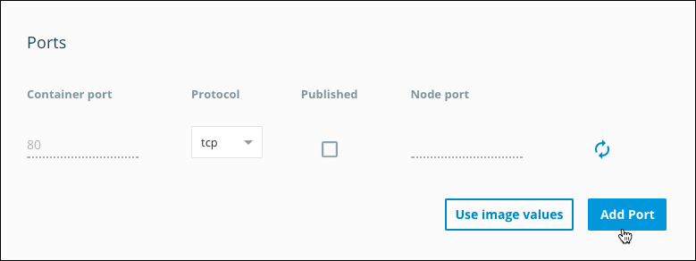
Launch a Service with an exposed port
If the image that you are using for your service already exposes any ports, these appear in Docker Cloud in the Launch new service wizard.

Slide 27
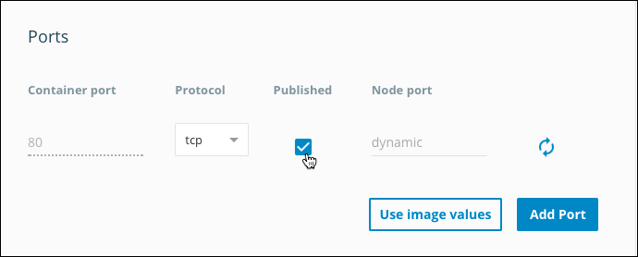
Launch a Service with a published port
If the image that you are using for your service already exposes any ports, these appear in Docker Cloud in the Launch new service wizard. You can choose to publish and map them from the wizard.

Slide 28
Check which ports a service has published
The Endpoints section in the Service view lists the published ports for a service.
The Service endpoints list shows the endpoints that automatically round-robin route to the containers in a service.
The Container endpoints list shows the endpoints for each individual container. Click the blue “link” icon to open the endpoint URL in a new tab.

Slide 29
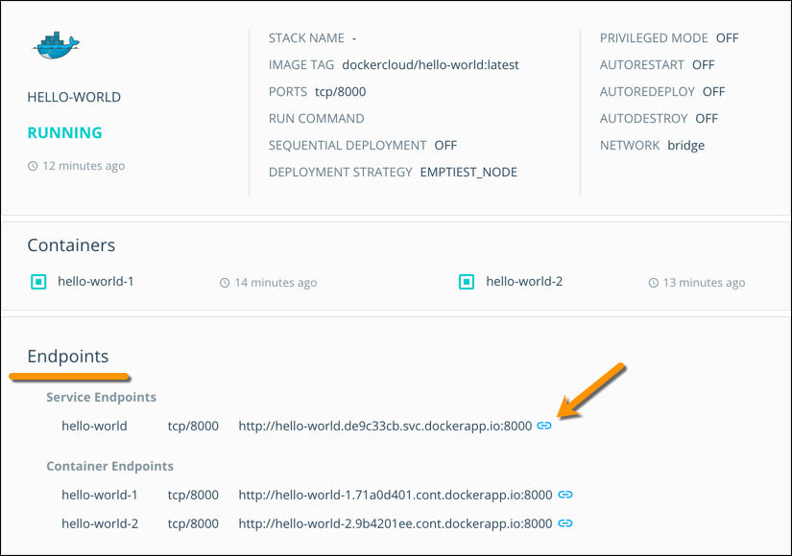
Check which ports a service has published

Slide 30
Naming our Docker Containers
Create a Docker container, is assigned a universally unique identifier (UUID).
These are essential to avoid naming conflicts and promote automation without human intervention.
They effectively identify containers to the host and network.
1. Name the container when you run it docker run --name=meaningful_name
For example, if we ran a container based on the nginx base image and started it like this:
docker run --name nginx -d nginx

Slide 31
Naming our Docker Containers
2. Assign a hostname to the container docker run --hostname=value OR docker run -h value
While --name and --hostname are both useful for Identification of containers
3. Automatically delete containers when they exit
docker run --rm

Slide 32
Docker Events
Get real time events from the server
docker events [OPTIONS]
Use docker events to get real-time events from the server. These events differ per Docker object type.
Object Types
CONTAINERS | SERVICES
IMAGES | NODES
PLUGINS | SECRETS
VOLUMES | CONFIGS
NETWORKS
DAEMONS

Slide 33
Docker Events
Object Types - CONTAINERS
attach | die | kill | start
commit | exec_create | oom | stop
copy | exec_detach | pause | top
create | exec_start | rename | unpause
destroy | EXPORT | RESIZE | UPDATE
detach | health_status | restart

Slide 34
Docker Events
Object Types - IMAGES
delete | tag
import | untag
load
pull
push
save
Object Types - PLUGINS
enable
disable
install
remove

Slide 35
Docker Events
Object Types - VOLUMES
create
destroy
mount
unmount
Object Types - NETWORK
create
connect
destroy
disconnect
remove

Slide 36
Docker Events
Object Types - DAEMONS
RELOAD
Object Types - SERVICES
create
REMOVE
UPDATE
Object Types - NODES
create
REMOVE
UPDATE

Slide 37
Docker Events
Object Types - SECRETS
create
REMOVE
UPDATE
Object Types - CONFIGS
create
REMOVE
UPDATE

Slide 38
What are Docker tags?
Docker tags convey useful information about a specific image version/variant.
They are aliases to the ID of your image which often look like this: f1477ec11d12.
It’s just a way of referring to your image.
A good analogy is how Git tags refer to a particular commit in your history.

Slide 39
Taking Control of Our Tags
When building an image, we use the following command:
docker build -t username/image_name:tag_name .
Explicitly tagging an image through the tag command.
docker tag SOURCE_IMAGE[:TAG] TARGET_IMAGE[:TAG]
Tag an image referenced by ID
docker tag 0e5574283393 fedora/httpd:version1.0

Slide 40
Taking Control of Our Tags
Tag an image referenced by Name
docker tag httpd fedora/httpd:version1.0
Tag an image referenced by Name and Tag
docker tag httpd:test fedora/httpd:version1.0.test
Tag an image for a private repository
docker tag 0e5574283393 myregistryhost:5000/fedora/httpd:version1.0

Slide 41
Pushing & Pulling to Docker Hub
Understanding where images come from
Pulling a Docker image from Docker Hub
Pushing a Docker image to Docker Hub

Slide 42
Pushing & Pulling to Docker Hub
Getting an image from Docker Hub
Docker Hub is the place where open Docker images are stored. When we ran our first image by typing
docker run --rm -p 8787:8787 rocker/verse
Pull image from docker Hub
docker pull rocker/verse

Slide 43
Pushing & Pulling to Docker Hub
Getting an image to Docker Hub
Log in on https://hub.docker.com/
Click on Create Repository.
Choose a name (e.g. verse_gapminder) and a description for your repository and click Create.
Log into the Docker Hub from the command line
docker login --username=yourhubusername --email=youremail@company.com

Slide 44
Pushing & Pulling to Docker Hub
Check the image ID using
docker images
tag your image
docker tag bb38976d03cf yourhubusername/verse_gapminder:firsttry
Push your image to the repository you created
docker push yourhubusername/verse_gapminder

